Slide 1
















T.T
T.T
Tear tRANSLATOR
GDSC KOREA DAU
BUMKU CHOI
DAYEONG KANG
HAJIN KIM
HYEYOUNG KIM

Slide 2


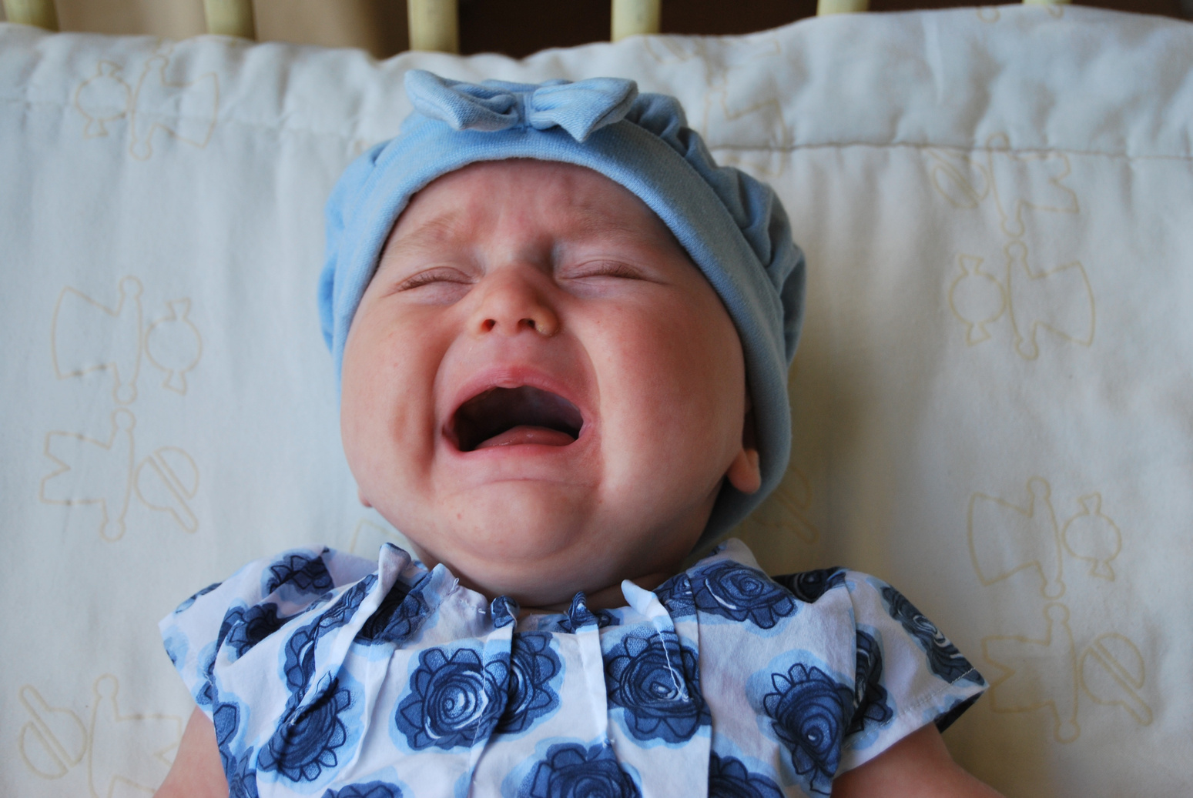



Why is
my child crying?
For parents,
who are new and only know how to soothe their crying child without knowing the reason and who are bewildered by their child's incessant crying.
Let's create an app that uses AI to analyze a baby's crying sounds to identify the cause

Slide 3






target
SDGs
target
SDGs
Cry Analysis can immediately reflect the needs of infants and toddlers to maintain a healthy life for infants and toddlers.
An app that speeds up information acquisition for the information vulnerable.
It can solve inter-floor and inter-wall noise that can be caused by a child's crying.

Slide 4












fRONTEND
BackEND
AI
Flutter
APP START
Flask
response
inference
crying reason
CRYING
RECORD
Using
Data
provide
crying reason
FILE
SEND
save as
training
data

Slide 5

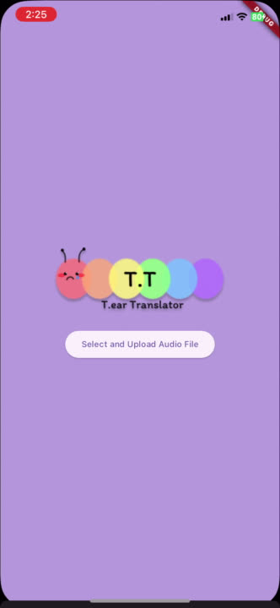




?Simulation
Let's take a look at the actual service together!

Slide 6


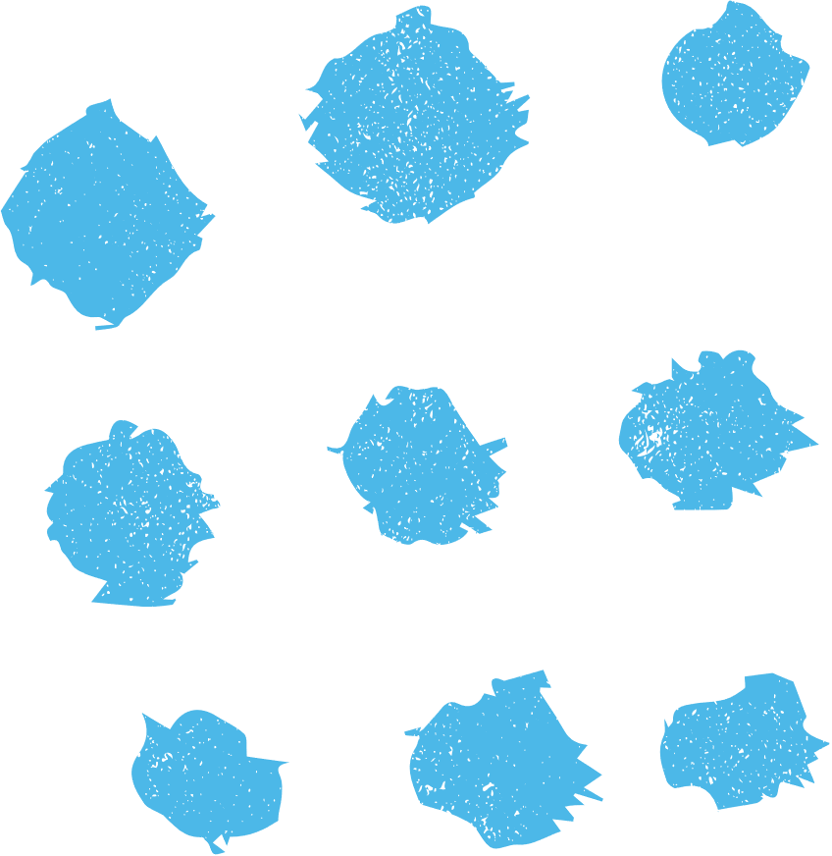




Quickly address your child's needs
an increase in parenting quality
parenting
Expected
values
parents
parental stress reduction
When using our app
guaranteeing a child's right to pursue happiness
baby

Slide 7
Thank you very much

